Slide 1
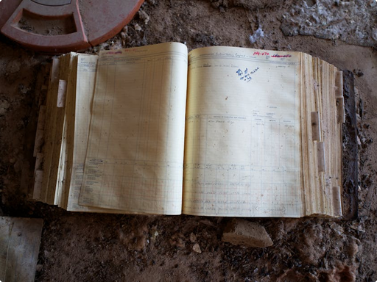
Investigation Report
2026-02-11
Jeffrey Epstein: Background
Jeffrey Epstein (1953-2019) was an American financier and convicted sex offender. Born in Brooklyn, New York, he began his career in finance, eventually establishing his own firm. His early career involved teaching mathematics and working at Bear Stearns, building connections that facilitated his later financial success and alleged illicit activities.
Notes:
Jeffrey Epstein, born in Brooklyn (1953), became a prominent American financier. Early in his career, he taught mathematics and worked at Bear Stearns, which helped him build a network. This network was crucial for his later financial ventures and also facilitated the alleged illicit activities that led to his conviction as a sex offender. His background is key to understanding his rise and fall.

Slide 2


Wealth Management Review
February 11, 2026
Rise to Wealth
Discreet Wealth Management
Provided financial oversight for ultra-high-net-worth individuals, emphasizing privacy and tailored investment strategies to grow substantial capital.
An individual amassed considerable wealth, estimated at over $577 million. This fortune was built by managing money for ultra-high-net-worth individuals, often with an emphasis on discretion. These extensive financial dealings enabled the acquisition of significant real estate, including a prominent townhouse in New York City, a vast ranch in New Mexico, and a private island.
Significant Real Estate Portfolio
Acquired diverse, high-value properties including a New York City townhouse, a New Mexico ranch, and a private island.
Notes:
This slide outlines the financial overview of an individual who accumulated over $577 million. It details their approach to managing money for ultra-high-net-worth individuals, prioritizing discretion. Additionally, it highlights the significant real estate acquisitions made through these financial dealings, including notable properties like a New York City townhouse, a New Mexico ranch, and a private island.

Slide 3
Palm Beach Police Department
February 11, 2026
Initial Complaint
Palm Beach police launched an investigation in 2005 after a complaint of sexual assault involving a minor.
Initial Allegations
In 2005, Palm Beach police began investigating Epstein after a complaint of sexual assault involving a minor. This led to a large-scale investigation, uncovering multiple allegations over time.
Widespread Allegations
The investigation quickly uncovered multiple additional allegations from numerous alleged victims.
Formal Indictment (2007)
By 2007, Epstein was indicted on charges of soliciting and procuring a minor for prostitution.
Notes:
Begin by setting the scene in 2005, when Palm Beach police initiated an investigation into Jeffrey Epstein based on a sexual assault complaint. Highlight how this initial complaint quickly escalated into a widespread investigation, revealing numerous allegations from over 30 alleged victims. Emphasize the formal indictment in 2007 for soliciting and procuring a minor, marking a significant legal development in the early stages of the case.

Slide 4
Justice Insights
February 11, 2026
Controversial 2008 Plea Deal
Federal N.P.A.
State Plea & Sentence
In 2008, Epstein accepted a non-prosecution agreement with federal prosecutors and a plea deal with state prosecutors in Florida. He pleaded guilty to two state charges of soliciting prostitution and received an 18-month sentence, serving 13 months with work release, sparking significant public outrage due to its leniency.
Accepted a non-prosecution agreement with federal prosecutors.
Guilty to 2 state charges, 18-month sentence, served 13 months.
Public Outrage
Significant public outrage due to the perceived leniency of the deal.
Notes:
The 2008 plea deal involving Jeffrey Epstein was highly controversial. It comprised a federal non-prosecution agreement and a state plea deal in Florida. Epstein pleaded guilty to soliciting prostitution, receiving an 18-month sentence but serving only 13 months with work release. This outcome sparked widespread public criticism for its perceived leniency, leading to ongoing scrutiny of the justice system and the handling of high-profile cases.

Slide 5
Legal Review Inc.
February 11, 2026
Re-emerging Charges
Investigative Scrutiny
Miami Herald's 2018 reporting reignited public and legal interest in the case, exposing previous leniency.
Despite a 2008 plea deal, investigative reporting by the Miami Herald in 2018 brought new attention to the case, highlighting the controversial nature of the previous agreement. This renewed scrutiny led to federal charges in July 2019, alleging sex trafficking of minors in Florida and New York over many years.
Prior Agreement Controversy
The 2008 plea deal's terms and perceived leniency came under intense public and legal scrutiny.
Federal Indictment
July 2019 brought new federal charges for alleged sex trafficking of minors in multiple states.
Notes:
Following a controversial 2008 plea deal, renewed scrutiny emerged in 2018 due to investigative journalism. The Miami Herald's exposé brought the case back into the spotlight, questioning the previous agreement's terms. This led directly to new federal charges filed in July 2019. These charges centered on allegations of sex trafficking involving minors across Florida and New York over an extended period. The re-emergence of these charges marked a significant development in the ongoing legal saga.

Slide 6
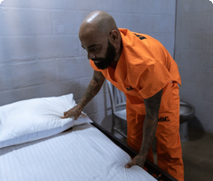
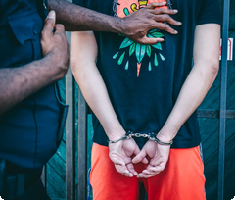
Legal Case Analysis
February 11, 2026
Arrest and Death in Custody
Initial Arrest & Charges
Epstein was arrested on July 6, 2019, facing sex trafficking charges. He consistently maintained his innocence throughout the legal proceedings.
Jeffrey Epstein was arrested on July 6, 2019, charged with sex trafficking, pleading not guilty. He was found dead in his Metropolitan Correctional Center cell on August 10, 2019. The official cause was suicide by hanging, but this ruling remains highly controversial, sparking extensive public and legal debate.
Death in Custody & Aftermath
His death on August 10, 2019, in his cell was ruled a suicide. This ruling sparked widespread skepticism and ongoing investigations.
Notes:
Reviewing the key events surrounding Jeffrey Epstein's case. We'll cover his initial arrest on sex trafficking charges and the controversial circumstances of his death in custody, which has generated significant public and legal scrutiny.

Slide 7

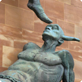
Federal Prosecution
February 11, 2026
Aftermath
Key figures linked to the ongoing investigations following Epstein's death and Maxwell's conviction.
Ghislaine Maxwell
Jeffrey Epstein
Convicted Associate
Deceased Financier
Epstein's associate. Convicted Dec 2021 on five sex trafficking counts, including minors. Sentenced to 20 years in 2022.
His death initiated continued investigations into sex trafficking, leading to his associate's prosecution and conviction.
Notes:
This slide details the legal aftermath following Jeffrey Epstein's death, focusing on Ghislaine Maxwell's role and subsequent conviction. Maxwell was a key associate in Epstein's sex trafficking network. Her arrest and trial were significant milestones in bringing justice to victims. The conviction and sentencing underscore the ongoing efforts to address and penalize such heinous crimes. The investigations highlighted the extensive nature of the network.

Slide 8
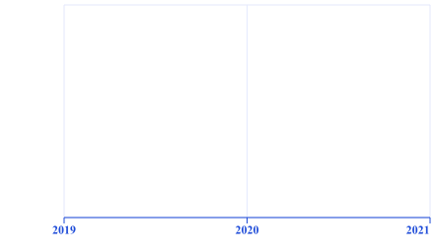
Justice System Insights
2026-02-11
Lasting Impact and Lingering Questions
Epstein's case exposed profound systemic failures within the justice system and highlighted victim vulnerabilities. His death in custody sparked numerous conspiracy theories. Civil lawsuits continue, with substantial settlements for victims, leaving critical questions about his network unanswered.
2019
2020
2021
Notes:
The Epstein case revealed significant flaws in legal processes and protective measures for victims. His death generated widespread suspicion, leading to ongoing civil litigation and substantial compensation for victims. The full scope of his associates and activities remains largely unaddressed, prompting ongoing public and legal scrutiny.

